Slide 1
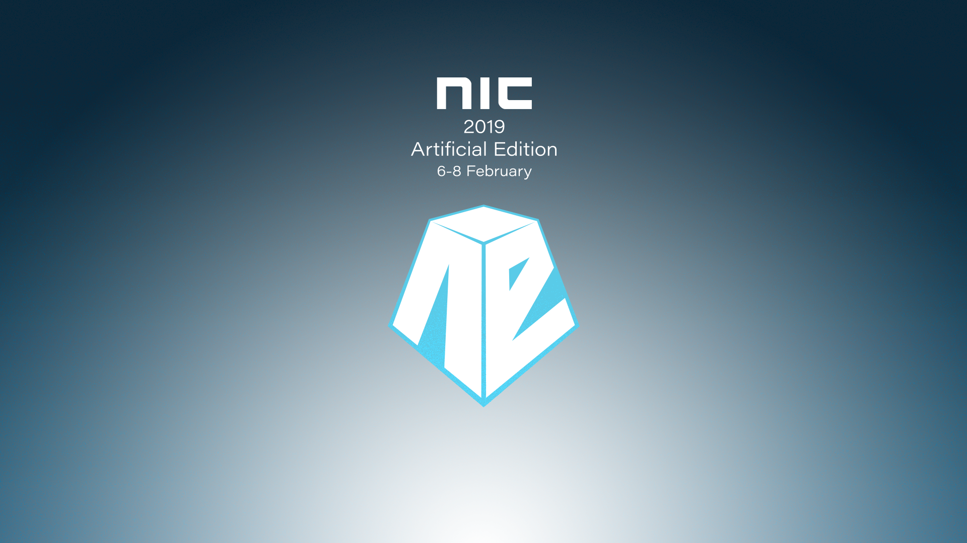

Slide 2
What’s new in Enterprise Client Management

Slide 3

Kent Agerlund
CTGlobal Principal Consultant and Microsoft Enterprise Mobility MVP & Regional Director
kea@ctglobalservices.com @Agerlund

Slide 4

Marius A. Skovli
CTGlobal Principal Consultant and Microsoft Enterprise Mobility MVP
mas@ctglobalservices.com @MariusSkovli

Slide 5
Agenda
Configuration Manager
Support information
What was added in 1806
What was added in 1810
What is included in Technical Previews
Intune
Autopilot (quick update incl. Hybrid Azure AD join)
Win32 App support (MSIX and IntuneWin)
Administrative templates (Public Preview)
Security Baseline (Public Preview)
(Issue SCEP certificates to user-less devices)
(Simplified administration)

Slide 6

Configmgr support information
Version | Availability Date | Support End Date
1706 | July 31, 2017 | July 31, 2018
1702 | March 27, 2017 | March 27, 2018
1610 | November 18, 2016 | November 18, 2017
1606 | July 22, 2016 | July 22, 2017
1602 | March 11, 2016 | March 11, 2017
1511 | December 8, 2015 | December 8, 2016
1710 | November 20, 2017 | May 20, 2019
1802 | March 22, 2018 | September 22, 2019
1806 | July 31, 2018 | January 31, 2020
1810 | November 27, 2018 | May 27, 2020

Slide 7
What’s New in 1806
Super quick overview

Slide 8
Site infrastructure
CMPivot
Site server high availability
Management insights improvements
Configuration Manager tools
Exclude Active Directory containers from discovery

Slide 9

Slow Moving Software

Slide 10
Challenges
Constant Change
Instant Gratification
User Response Time

Slide 11


Slide 12

Real-Time
Relating to a system in which input data is processed within milliseconds so that it is available virtually immediately as feedback.

Slide 13
Real-Time For System Admins
Relating to a system in which input data is processed within a few minutes so that it is available within a few minutes as feedback.

Slide 14




Client Notification
Fast Channel or Big Green Button (BGB)
Client initiated,
two-way channel
Initiate Action
Management
Point
Real-time communication
Added in ConfigMgr 2012 SP1
Port 10123, fallback to HTTP(s)
Keep-alive sent every 15 (tcp) or 5 (http) minutes
Results returned using high priority state messages

Slide 15

Client Notification
IBCM or CMG
Initiate Action
Management
Point
CMG

Slide 16
Client Notification
Doesn’t Require
DNS name resolution of clients
Admin permissions on clients
Firewall rules on clients [inbound]
Client initiated,
two-way channel
Management
Point

Slide 17


Client Notification
vs. Right-Click Tools
 | Client Notification | Right-Click Tools
Connection via | Management Point | Admin Console
DNS Resolution of Client Necessary | No | Yes
Firewall Exceptions on Client Necessary | No | Yes
Local Admin Permissions on Client Necessary | No | Yes
Connection Method | Parallel (42 at a time) | Serial (1 at a time)
Native functionality | Yes | No
Monitoring | Built-in to console | No
Easily extensible | Yes, using scripts | Yes, but not as easy
Approval mechanism | Yes | No
Client Notification > Right-Click Tools

Slide 18
Client Notification
New in 1810
Improved State Message Processing (MPE)
Bypasses inbox
Direct write to DB
Decreases result return times
Management
Point

Slide 19


Slide 20
Content management
Configure a remote content library for the site server
Cloud distribution point support for Azure Resource Manager
Pull-distribution points support cloud distribution points as source
Enable distribution points to use network congestion control
Partial download support in client peer cache to reduce WAN utilization
Boundary group options for peer downloads
Improvement to peer cache source location status

Slide 21
Client management
Improvement to client push security
Enhanced HTTP site system
Azure AD device identity
CMTrace installed with client
Cloud management dashboard
Improvements to cloud management gateway

Slide 22
Co-management
Sync MDM policy from Microsoft Intune for a co-managed device
New workloads
Device configuration
Office 365
Mobile apps
Support for multiple hierarchies to one Intune tenant

Slide 23
Compliance settings
Configure Windows Defender SmartScreen settings for Microsoft Edge
SCAP extensions

Slide 24
Application Management
Phased deployment of applications
Provision Windows app packages for all users on a device
Office Customization Tool integration with the Office 365 Installer
Support for new Windows app package format MSIX
Uninstall application on approval revocation
Package Conversion Manager

Slide 25
OS deployment
Improvements to phased deployments
Create a phased deployment with manually configured phases
Phased deployment status
Gradual rollout during phased deployment
Improvements to Windows 10 in-place upgrade task sequence
Improvements to PXE-enabled distribution points
Network access account not required for some scenarios
And Some additional minor changes

Slide 26
Software Center
Software Center infrastructure improvements
Specify the visibility of the application catalog website link in Software Center
Custom tab for webpage in Software Center
Maintenance windows in Software Center

Slide 27
Software updates
Third-party software updates
Deploy software updates without content
Filter automatic deployment rules by software update architecture
Improved WSUS maintenance
New software updates compliance report

Slide 28
What’s New in 1810

Slide 29
Site infrastructure
Support for Windows Server 2019
Hierarchy support for site server high availability
Improvements to setup prerequisites

Slide 30
Content management
New boundary group options
Prefer distribution points over peers with the same subnet
Prefer cloud distribution points over distribution points
Management insights rule for peer cache source client version

Slide 31
Client management
Client notification action to wake up device
Option to perform client notification from devices node
Improvements to collection evaluation
Improvement to client installation
Improvements to internet-based client setup

Slide 32
Co-management
Required app compliance policy for co-managed devices
Improvement to co-management dashboard

Slide 33
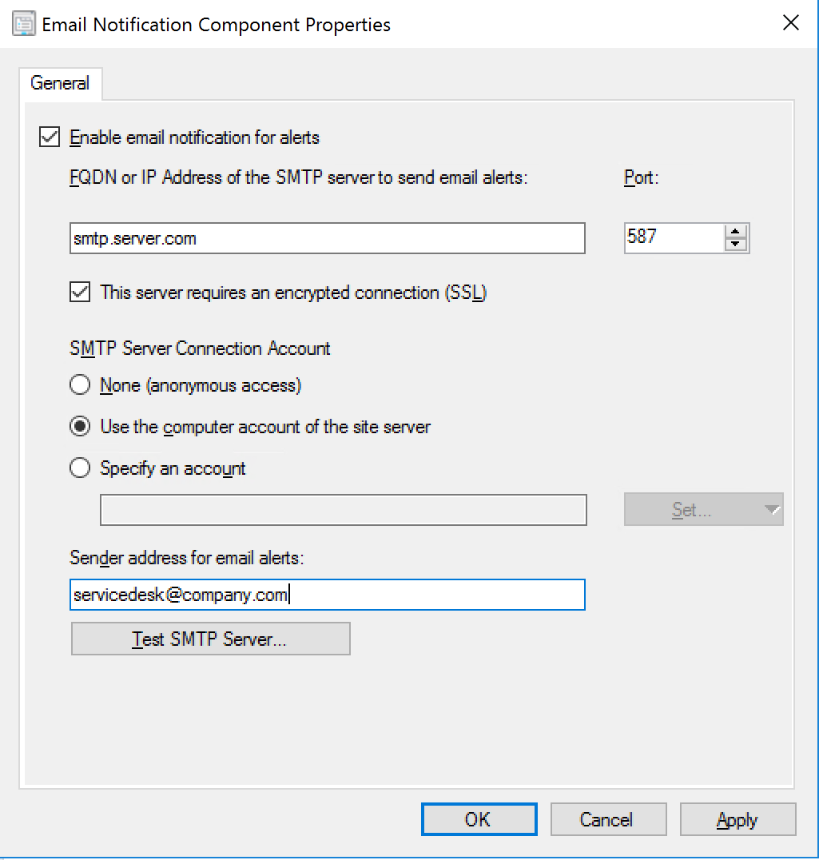
Application management
Convert applications to MSIX
Repair applications
Approve application requests
Email
Machine-based pre-approved requests (SDK Only)
Re-approve a previously denied application request (SDK only)
https://techcommunity.microsoft.com/t5/Configuration-Manager-Blog/Application-approval-improvements-in-ConfigMgr-1810/ba-p/303534#Machine-based%20pre-approval%20requests

Slide 34
OS deployment
Task sequence support of Windows Autopilot for existing devices
Specify the drive for offline OS image servicing
Task sequence support for boundary groups
Improvements to driver maintenance
New task sequence variable for last action name

Slide 35
Software Updates
Phased deployment of software updates
Improvement to maintenance windows for software updates

Slide 36
Console
Configuration Manager administrator authentication
Support Center
Management insights dashboard
Improvements to CMPivot
Improvements to scripts
SMS Provider API

Slide 38
What’s New in Technical Previews
In other words, what we could see in future production releases

Slide 39
What are Technical Previews?
Technical Previews are pre-release builds that provide a look at new features that may get implemented in a future production release
Technical Preview sites are NOT production sites
They are very limited in client count, operating systems, configuration
And they expire every 90 days if not kept up to date
Features should ‘move’ from Technical Preview to Production when ready based on testing feedback

Slide 40
1901
Client health dashboard
Specify priority for feature updates in Windows 10 servicing
Dedicated monitoring for phased deployments
Improvements to Run PowerShell Script task sequence step
Management insight rules for collections
Search device views using MAC address
Distribution point maintenance mode
Optimized image servicing
Import a single index of an OS image
Stop cloud service when it exceeds threshold
Create a Configuration Manager technical preview lab in Azure
Specify a custom port for peer wakeup

Slide 42
What’s New in Intune

Slide 43
Windows Autopilot deployment
Three simple steps
Cloud driven
Register devices
Assign an Autopilot profile to the devices
Ship the device to the user

Slide 44
Traditional Windows deployment // The old way
OFFICE & APPS
DRIVERS
POLICIES
SETTINGS
Build a custom image, gathering everything else that’s necessary to deploy
Deploy image to a new computer, overwriting what was originally on it
Time means money, making this an expensive proposition

Slide 45
Modern Windows deployment // The new way
Un-box and turn on off-the-shelf Windows PC
Transform with minimal user interaction
Device is ready for productive use

Slide 46
Windows Autopilot User-Driven Hybrid Azure AD join

Slide 47
Windows Autopilot // User-Driven deployment with Hybrid Azure AD
Prerequisites:
Windows 10 version 1809
Azure Active Directory Premium
Microsoft Intune
Steps:
Set up ODJ connector from AD to Intune
Device connected to corporate network
Register device with Windows Autopilot
Assign Intune Autopilot Profile configured for Hybrid Azure AD join
Boot device

Slide 48
Windows Autopilot // User-Driven deployment with Hybrid Azure AD
Intune
Windows Autopilot Deployment Service
DC
Offline Domain Join Connector
Complete Join over corp net
Receive ODJ
MDM enrollment
Autopilot profile
Hardware ID
Receive GPOs over corp net
IT Admin
Employee unboxes device, self-deploys

Slide 49
Demo | Hybrid Azure AD join

Slide 50
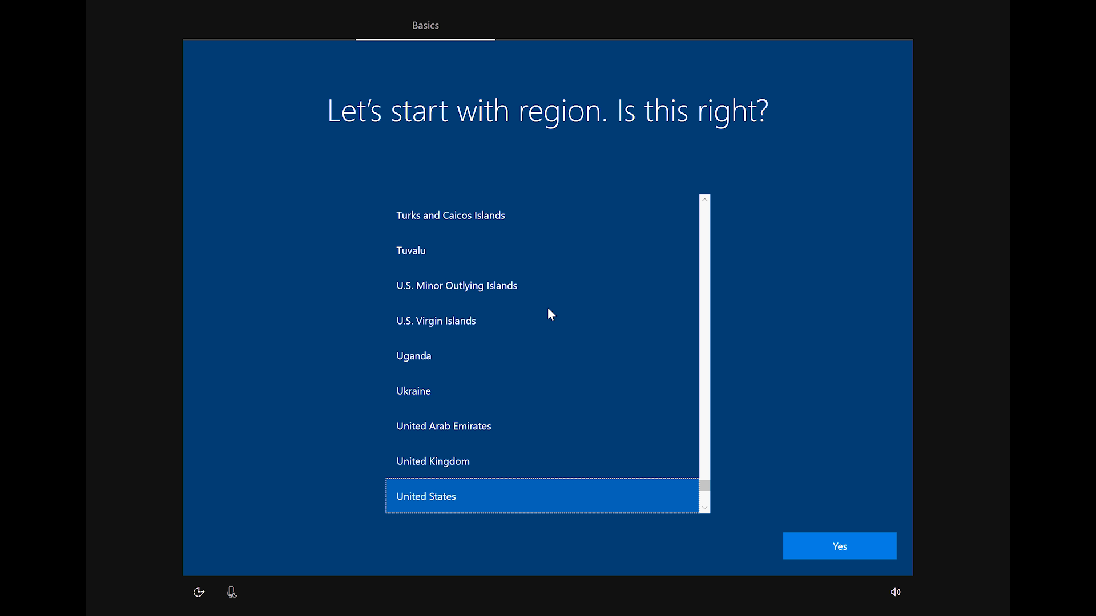

Slide 51
January 14, 2020

Slide 53
Apps
MSIX
MSIX uses the containerization technology available in Windows
Clean removal of packages
No administrative credentials needed for integration
Block level differential update
Global/per user targeting of applications
Native integration into current and future Operating System versions
Supported by Intune & Configuration Manager
Win32 app integration with Intune
IntuneAppUtil

Slide 54
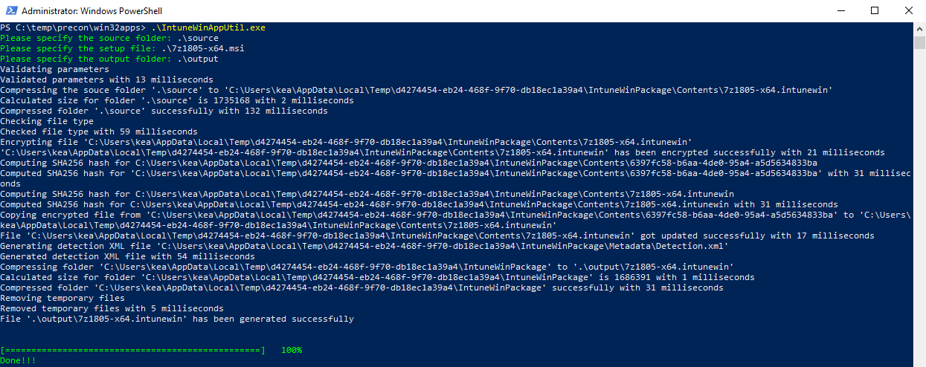
IntuneAppUtil

Slide 55
Prepping the content
Download tool
Generates app manifest
Encrypt installation files
Convert installation files
GitHub
.intunewin

Slide 57
Administrative templates (Out with the old…)
Administrative templates include about 300 settings that can be managed in Intune. Previously, these settings only existed in the group policy editor.
Administrative templates are available in public preview.
Administrative templates are moving from Device configuration > Administrative templates to Device configuration > Profiles > Create profile > in Platform, choose Windows 10 and later > in Profile type, choose Administrative templates.
Reporting is enabled

Slide 58
Windows 10 security baseline in Intune
A security baseline includes the best practices and recommendations on settings that impact security. Intune partners with the same Windows security team that creates group policy security baselines. These recommendations are based on guidance and extensive experience.
If you're brand new to Intune, and not sure where to start, then security baselines gives you an advantage. You can quickly create and deploy a secure profile, knowing that you're helping protect your organization's resources and data.
If you currently use group policy, migrating to Intune for management is much easier with these baselines. These baselines are natively built in to Intune, and include a modern management experience.
Note: When using co-managed devices, you must switch the Device configuration workload (its settings) to Intune

Slide 59



Security baseline creation process
Microsoft Security Assurance
Applicable for MDM/ AADJ?
Microsoft GP based security baseline
Yes
Microsoft MDM security baseline
External security experts
No
Microsoft Companion GPO Security baseline
Customer input

Slide 61

Slides and demos from the conference will be available at
https://github.com/nordicinfrastructureconference/2019

